Slide 1
Direct3d11 Renderer
William Little

Slide 2

Purpose
Industry skills
C++, 3D Rendering
2) Impressive Project

Slide 3
Demo

Slide 4

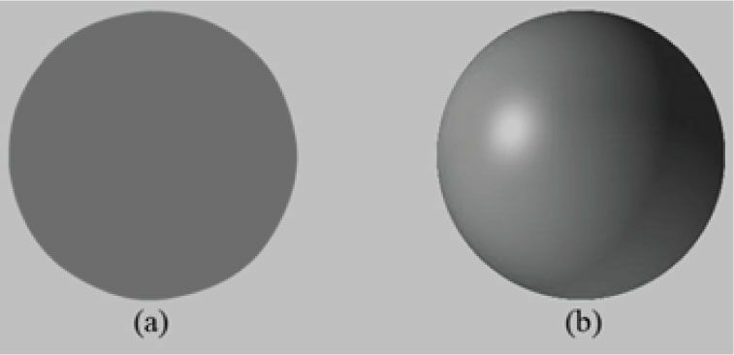
“Tricks” to 3d
Perspective
Lighting

Slide 5
Pillars
Device
Context
Swap Chain
Vertex Shader
Pixel Shader

Slide 6
Device
The ID3D11Device interface is used to check feature support and allocate resources.

Slide 7
Context
The ID3D11DeviceContext interface is used to set render states, bind resources to the graphics pipeline, and issue rendering commands.

Slide 8
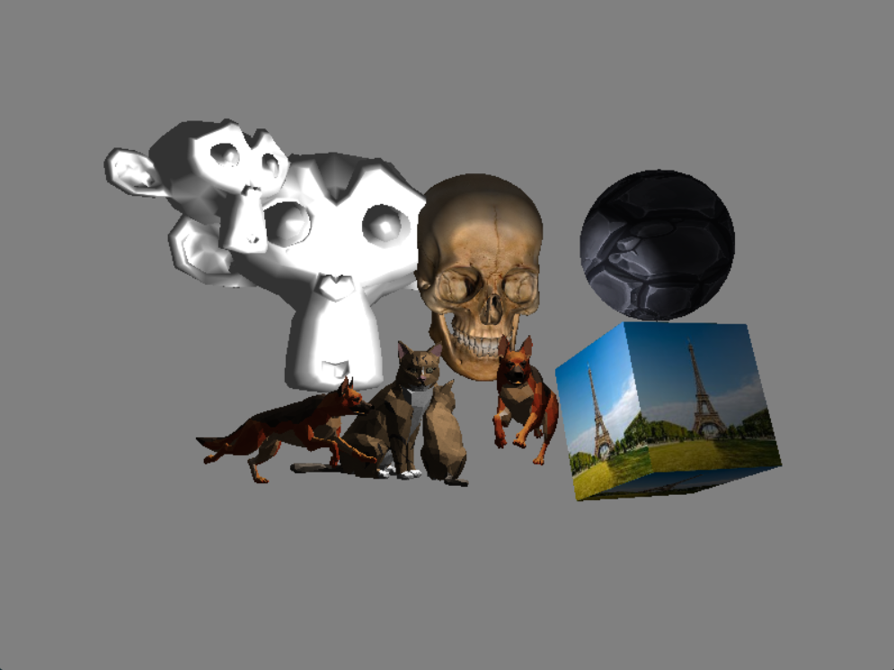
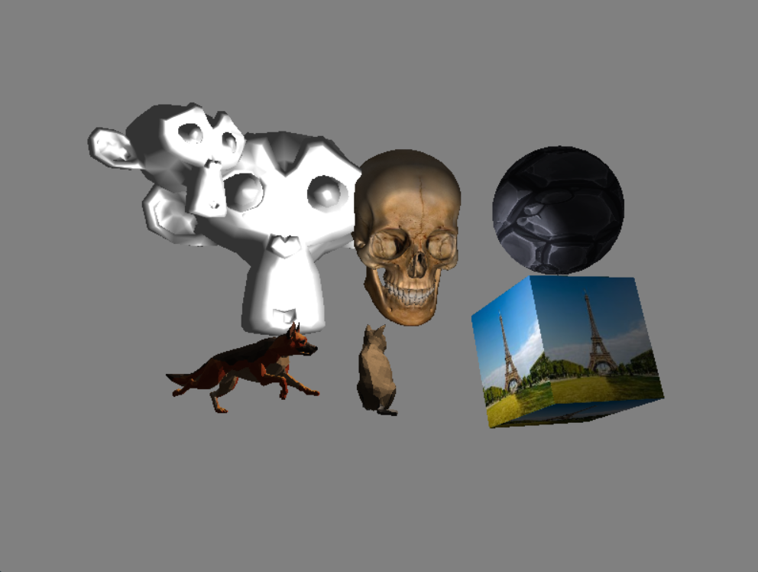
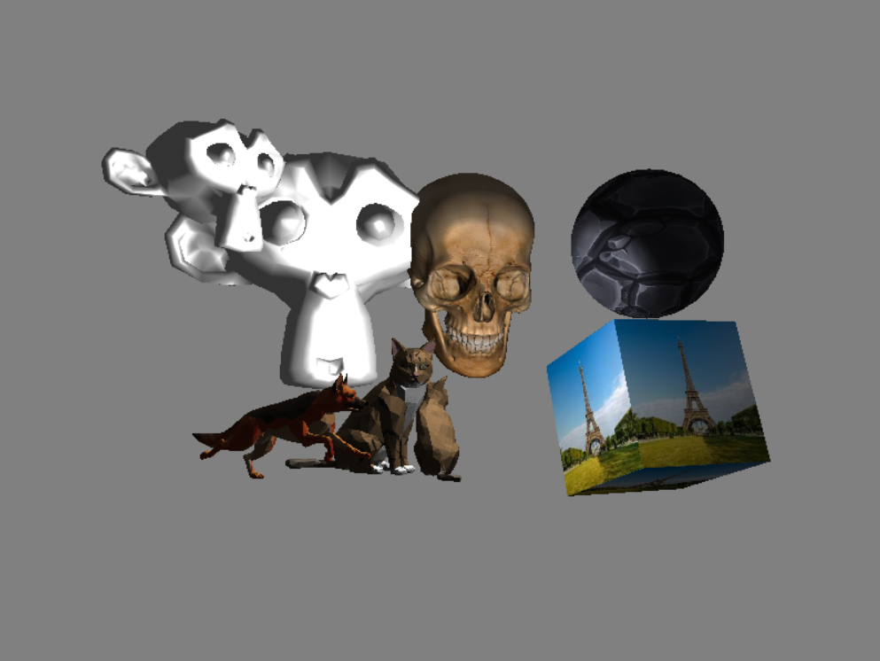
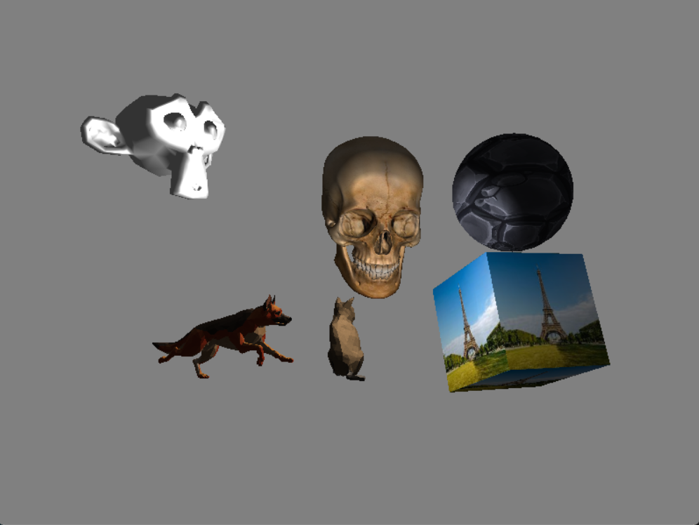

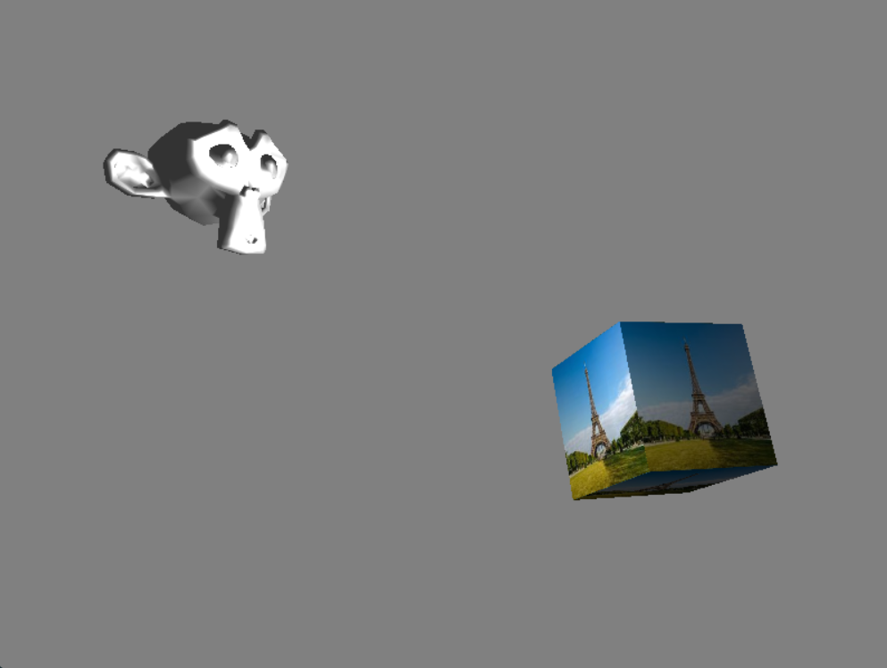
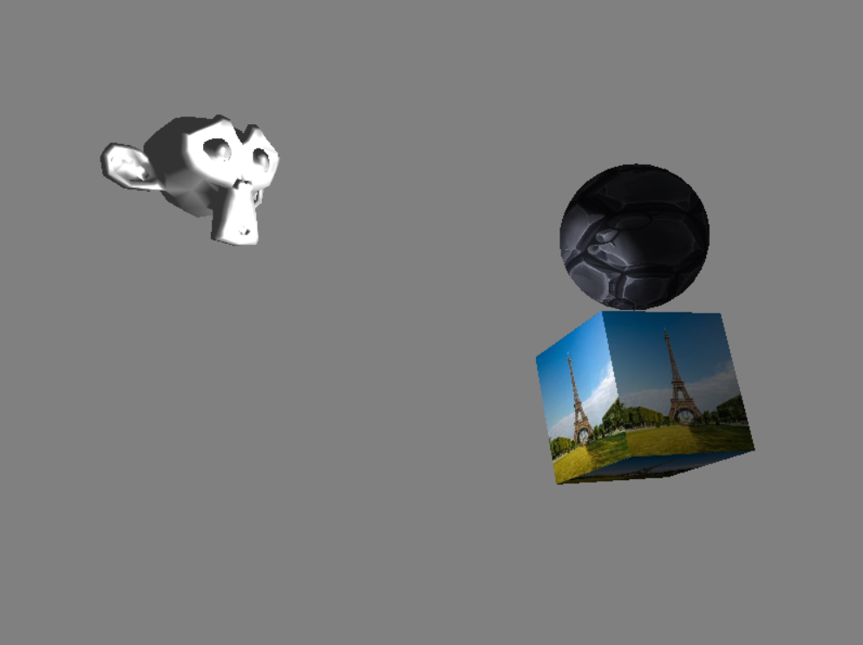
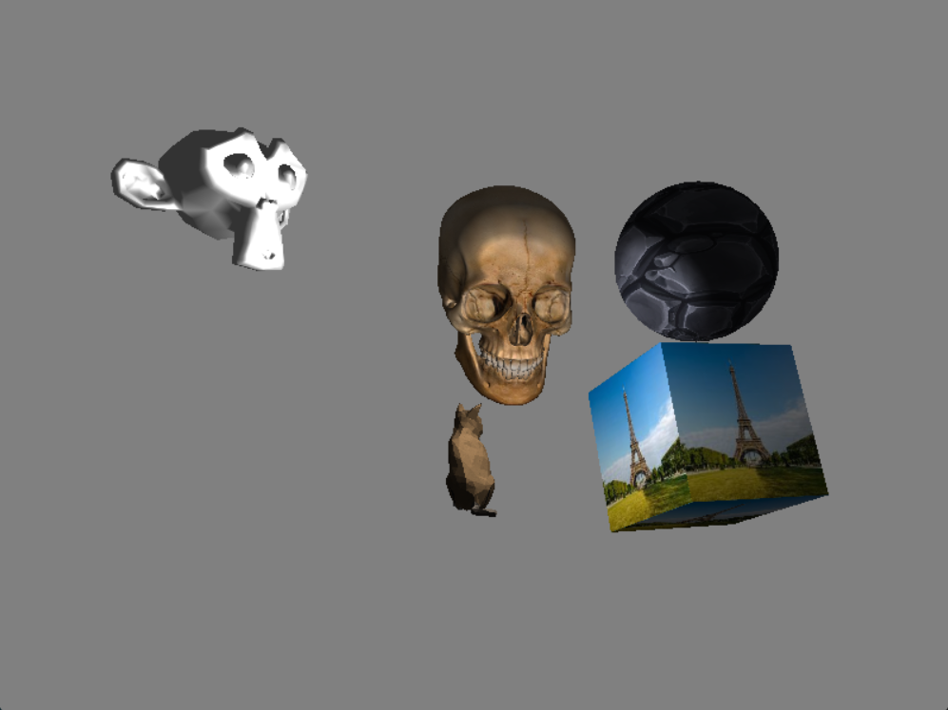
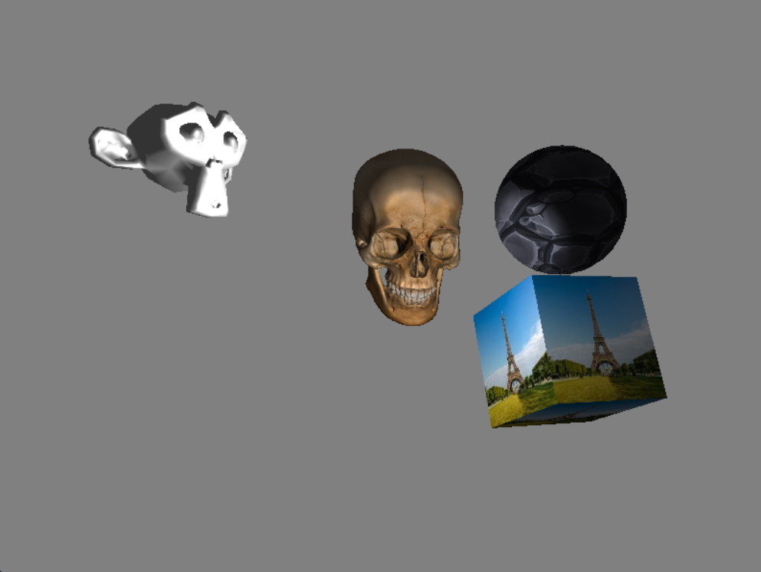
Swap Chain

Slide 9
Double Buffering

Slide 10
Vertex Shader
The vertex shader takes in vertices and translates, rotates, and scales them to build the perspective view.

Slide 11
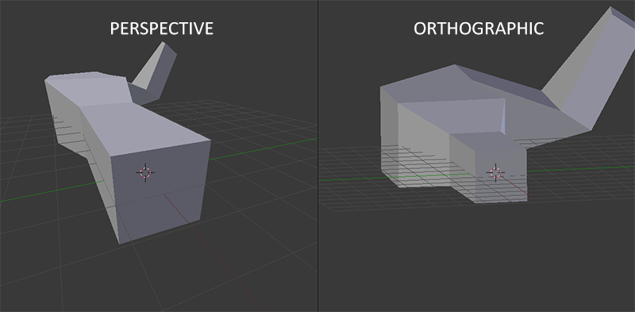
Vertex Shader
Objects are created and stored in local space.
They need to be moved to world space, then view space, then projection space.
This Photo by Unknown Author is licensed under CC BY-SA

Slide 12
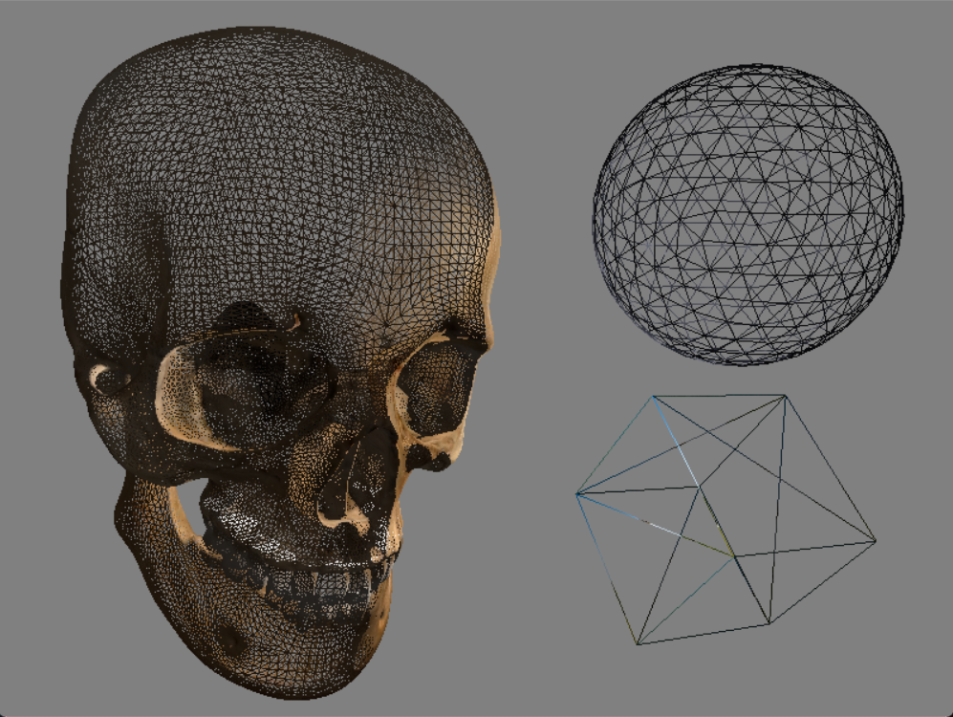
Vertex Shader

Slide 13

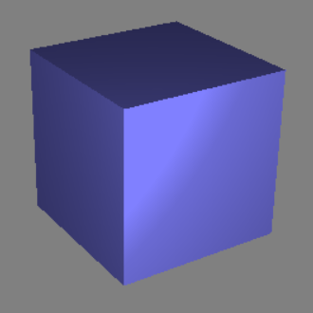

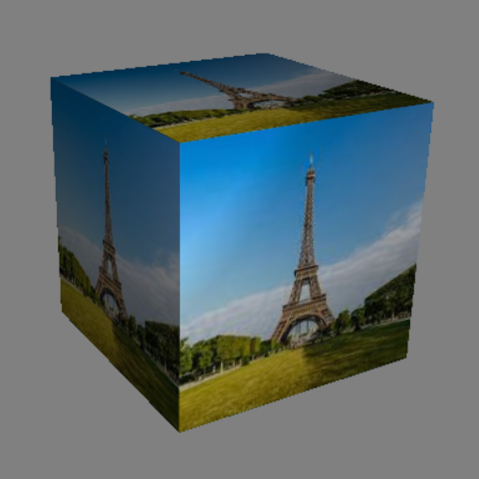
Pixel Shader
Determines color based on:
Texture
Lighting

Slide 14
Technologies
Project Technologies
Development Tools
Visual Studio
Visual Studio Graphics Analyzer
RenderDoc
Technology | Usage
C++ | Main programming language
Direct3D11 | Rendering API
HLSL | Graphics programming language
Technology | Usage
Visual Studio | Code Editor / Compiler
VS Graphics Analyzer | Graphics Debugger
RenderDoc | Graphics Debugger

Slide 15
Reflection
Struggles
Direct3D11 documentation
Steep learning curve
What went well:
Help from those who know

Slide 16
Conclusion
Much more confident in C++.
If I did it again, I would use OpenGL.
Plans:
Simplify and document for an example project
Build into a more useful engine / tool

Slide 17
Other Features
Load multi-mesh 3D Models (vertices, uv maps, normals)
Load textures
Render models with textures
Clear color
Skybox
Scenes
Phong lighting
Copy models
Transform models
Translate and rotate camera
Reload scene at runtime
Save scene to file
Delete models

Slide 18
Thank you
Questions?

